Slide 1


Amplicon Sequence Processing and Analysis in R
Mara Cloutier, muc345@psu.edu, https://maracloutier.weebly.com
twitter: @MaraCloutier
Mary Ann Bruns, mvb10@psu.edu, https://sites.psu.edu/soilmicrobiology/

Slide 2

DAWG – Data Analysis Working Group
Group of graduate students and post-docs aimed at:
1. Analyzing HTS data for a professor/delivering publication ready analyses/figures
2. Peer training- how to analyze HTS data through series of workshops

Slide 3
Sample Overview
Rhizosphere samples collected from field-grown Sorghum bicolor – in total there were 5 near isogenic lines that differed in their ability to produce flavonoids, in the workshop we just used 3 of the lines
We analyzed 16S rRNA amplicons, along with root chemical variables including total flavonoid content, total phenolic content, and DPPH activity (antioxidant activity)
Here is a link to our published open-access paper:
https://apsjournals.apsnet.org/doi/full/10.1094/PBIOMES-01-20-0013-FI

Slide 4
Quality filter and trim
Model errors
Dereplicate reads
Denoise reads
Merge F and R reads
Remove chimeric sequences
Assign taxonomy
Major data processing steps

Slide 5
What if you have two sets of amplicon sequences to analyze?
Let’s say that I have two sets of 16S rRNA amplicon sequences that I want to analyze (by sets, I mean samples from each set were run on two different Illumina MiSeq runs)
No problem!

Slide 6
Quality filter and trim
Model errors
Dereplicate reads
Denoise reads
Merge F and R reads
Remove chimeric sequences
Assign taxonomy
Set 1
Set 2
Full.nonchim <- mergeSequenceTables(set1.nonchim, set2.nonchim)
Taxa <- assignTaxonomy(Full.nonchim, database)
*DON’T FORGET TO RENAME YOUR FILES FOR EACH SET*********

Slide 7
Keep track of parameters you used, you’ll need those for publication Keep track of how many reads were lost at each step, you very well might need that information for publication

Slide 8
Quality filter and trim
Model errors
Dereplicate reads
Denoise reads
Merge F and R reads
Remove chimeric sequences
Assign taxonomy
Major data processing steps
In step # 11, we created a table to assess how many sequencing reads were lost at each of the major steps
input filtered denoised merged tabled nonchim
R1-3A 55259 50216 47853 41978 41978 38865
R1-4A 50491 45688 43252 37173 37173 36405
R1-5A 26894 25699 23531 19999 19999 19859
R2-3A 51714 47601 45058 39390 39390 38190
R2-4A 51516 45416 42511 35510 35510 35038
R2-5A 49850 45361 42751 37260 37260 35461
write.table(track, file =”Processed-Sequencing-info.txt")

Slide 9
What are the next steps?

Slide 10
Phyloseq object
Bar chart/heat maps
Alpha-diversity
Beta-diversity
Differential Abundance Analyses
Phylogenetic tree(?)
Linear modeling
RDA
PERMANOVA
Shannon diversity, Richness, Evenness
Breakaway (adw96.github.io/breakaway/)
Network Analyses
DESeq2
Corncob
NetCoMi
metacoder
PermDisp
Correlations
Taxa
Samples
MVAbund

Slide 11
Beta-Diversity
Start with PermDisp
Only interested in one or two independent variables?
Run Permanova
Interested in 2+ independent variables, consider running a rda coupled with selections to determine model with highest R2
>rda.1 <- rda(asv.table ~ DPPH + Flavs + Total_Phenols + Genotype, meta)
>rda.2 <- ordiR2step(rda.1, scope = formula(rda.1), direction = “both”, perm.max = 100)
>rda.2$anova # provides a summary table of the different models

Slide 12
MVAbund ≠ PERMANOVA
PERMANOVA is a distance-based analysis that assesses dissimilarities in ’groups’–
MVAbund (manyglm) – fits a generalized linear model to every taxa in the multivariate data
Uses these models to determine if the predictor variable has an effect on species composition
Can also determine what taxa differ by the predictor variable
See this website for more detailed information and a quick tutorial:
http://environmentalcomputing.net/introduction-to-mvabund/

Slide 13
Network Analyses, sooo many options
For detailed information on network analyses, what is calculated, and how you might want to perform different analyses and interpret the results, check out this book chapter: “Constructing and analyzing microbiome networks in R” – Layeghifard et al., 2018,
Here are some links to tutorials on network analyses in R:
https://grunwaldlab.github.io/metacoder_documentation/example.html
https://github.com/stefpeschel/NetCoMi
https://github.com/zdk123/SpiecEasi

Slide 14
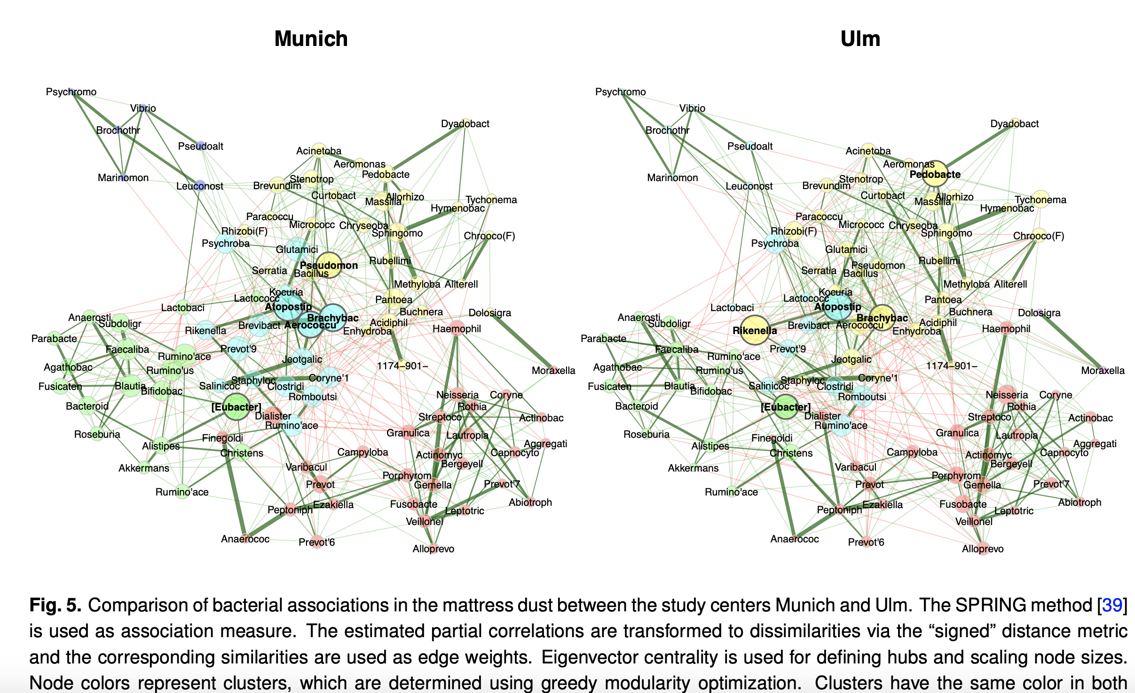
Network Analyses, Taxa Correlations
Peschel et al., 2020, bioRxiv

Slide 15
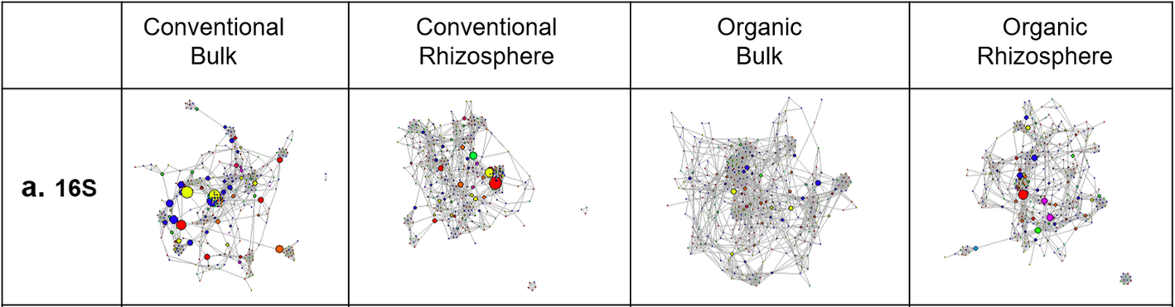
Look at connectedness/centrality/number of HUB taxa
Bacterial co-occurrence networks constructed from ASV-level data corresponding to each combination of management system and soil compartment have different structural characteristics. Nodes indicate amplicon sequence variants (ASVs) and edges represent significant co-occurrence relationships (Spearman’s ρ > 0.75 and p < 0.05). *Conventional networks had more edges but the same number of nodes as compared to organic networks. Furthermore, while the rhizosphere network had fewer edges than the bulk soil network in the conventional system, the rhizosphere network had more edges than the bulk soil network in the organic system.*
Schmidt et al., 2019, Microbiome

Slide 16
Incorporating Ancillary Variables

Slide 17
Phyloseq object
Bar chart/heat maps
Alpha-diversity
Beta-diversity
Differential Abundance Analyses
Phylogenetic tree(?)
Regression
RDA or CCA
Mantel Tests
PERMANOVA
Shannon diversity, Richness, Evenness
Breakaway (adw96.github.io/breakaway/)
Network Analyses
DESeq2
Corncob
NetCoMi
metacoder
Regressional analysis with extracted network properties
MVAbund

Slide 18
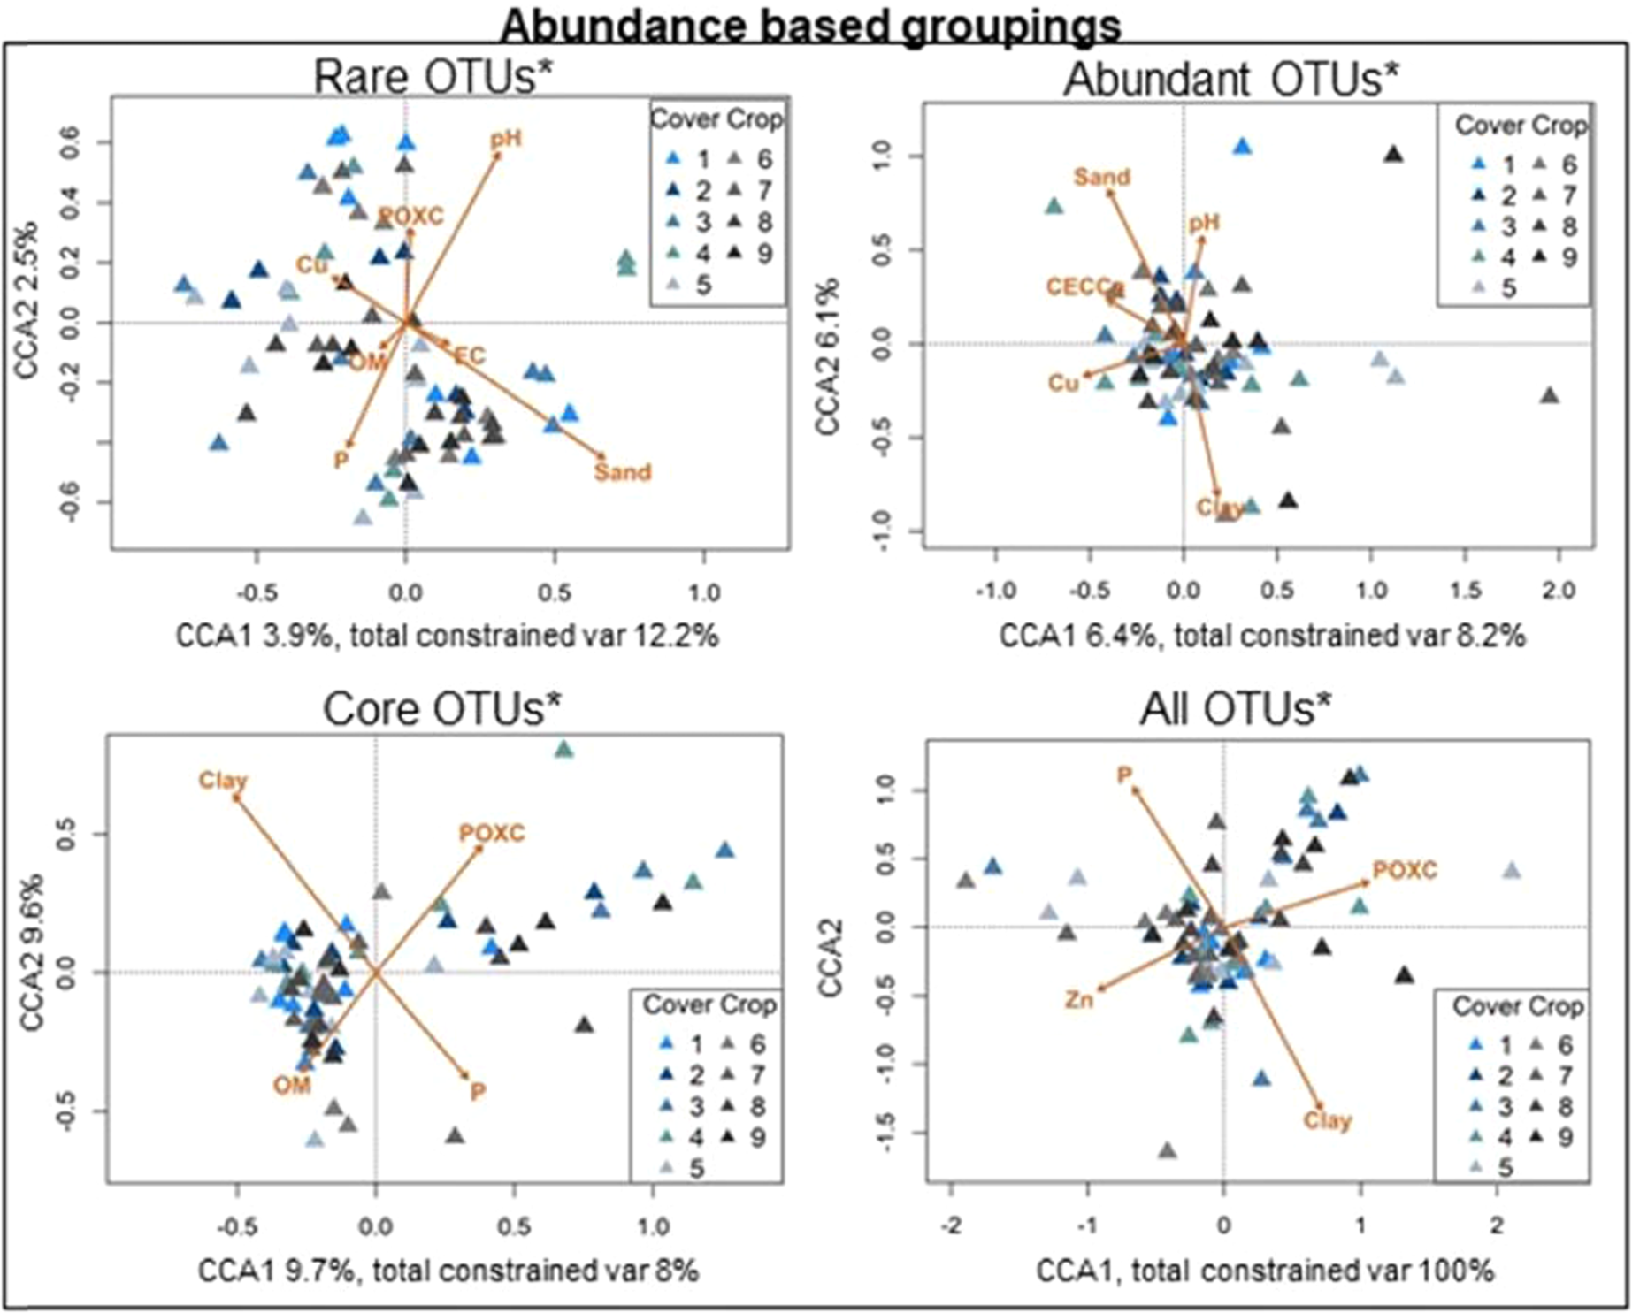
Constrained ordination plots using CCA models of OTU groupings. Important environmental variables selected using forward and backwards selection. (Supplementary Table 6). Each model that significantly explained the species dispersion across the OTU groupings are denoted with an *. Lengths of each vector indicate the correlation between the variable and the ordination. Percentages next to CCA1/CCA2 represent the amount of inertia explained by the axes, while total constrained var represents the amount of inertia accounted for by the vectors (environmental variables).
Cloutier et al., 2019, Scientific Reports

Slide 19
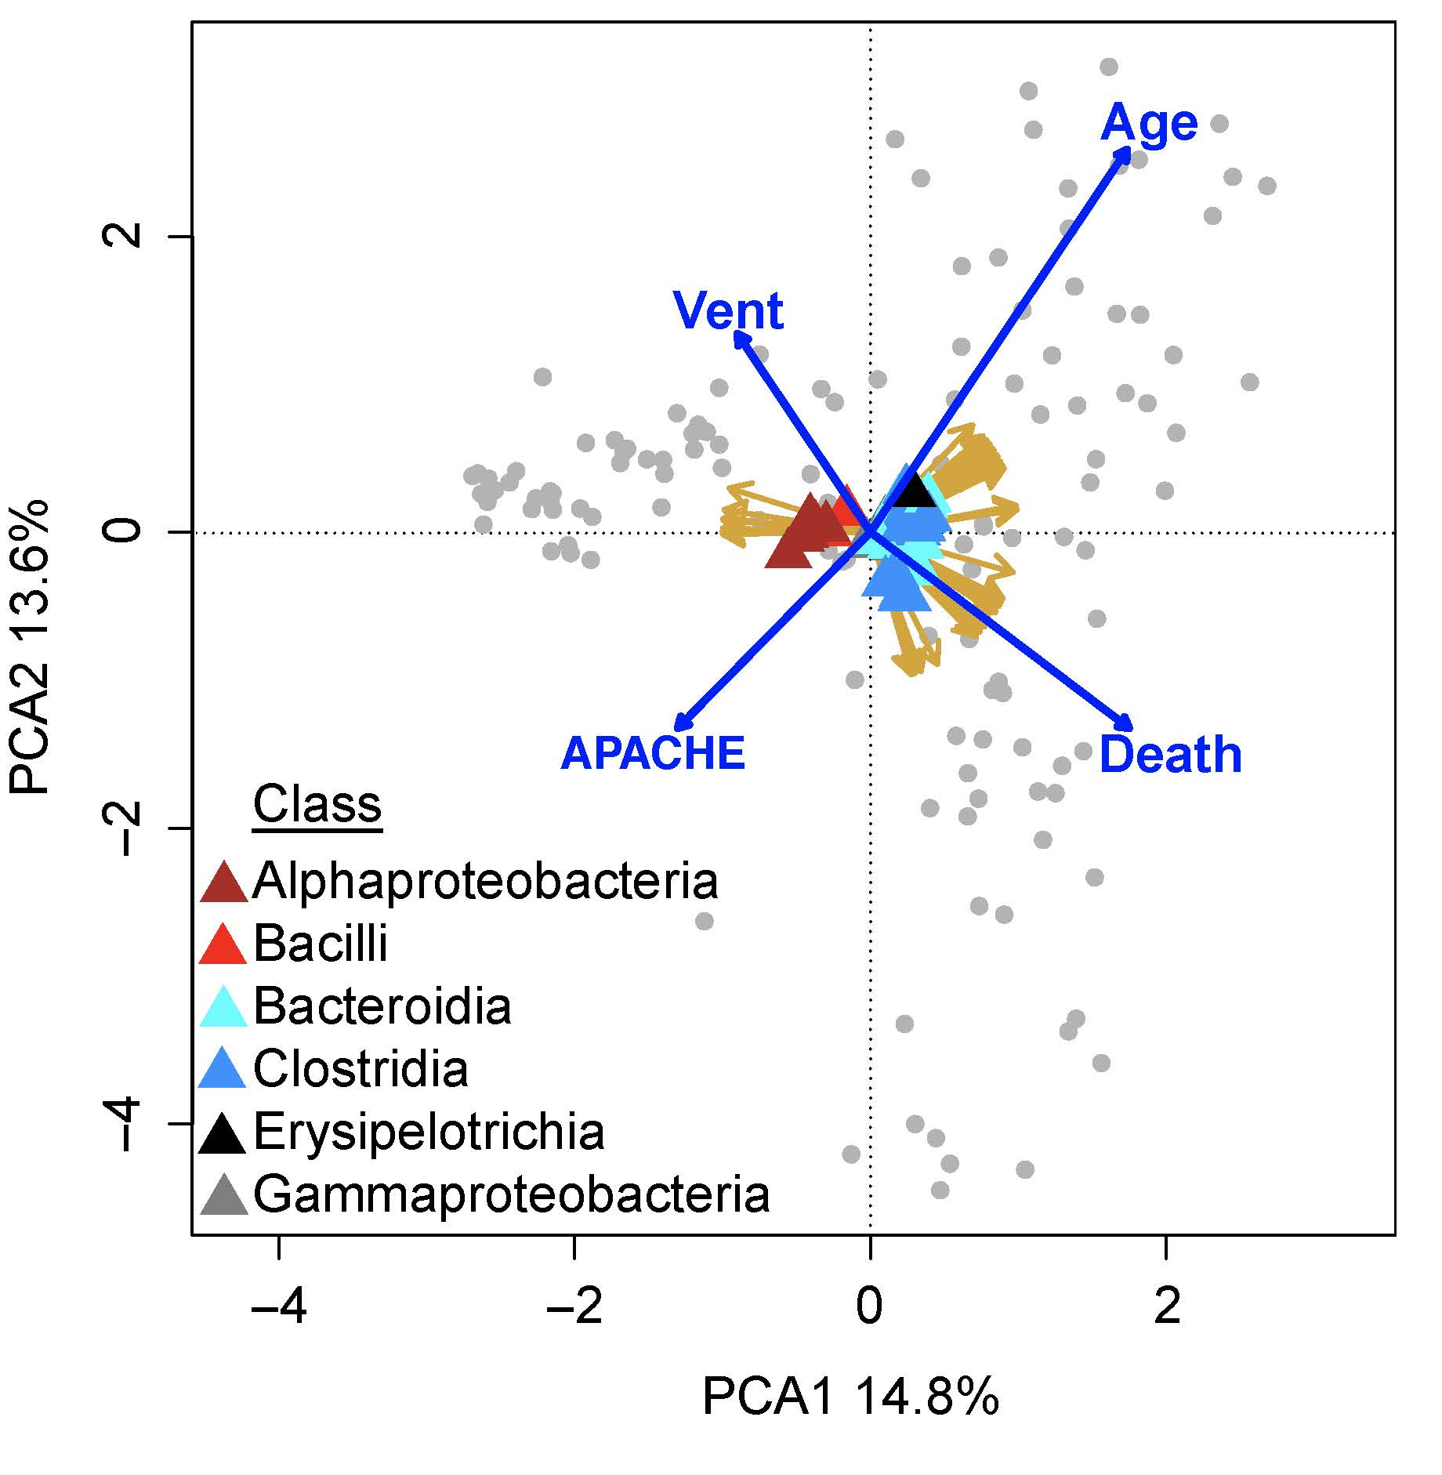
RDA – Redundancy Analysis
Similar to CCA but, how to decide?
Axis lengths!
If axis lengths are < 4, then it is assumed to be a linear model and RDA is the best choice
If axis lengths > 4, then it is assumed to be have a unimodal distribution and should use CCA

Slide 20
Checking for Axis lengths
# using the vegan package
>decorana(asv.table) # if longest axis(gradient) >4, switch to CCA or transform with ‘Hellinger’
# if you want to move forward with RDA and axis gradient is > 4, use the following
>asv.hell <- decostand(asv.table, “hell”)
>dbrda <- rda(asv.hell ~ DPPH + Flavs + any other variables, meta, distance = ‘bray’, scale = TRUE, na = na.omit)
# fit the vectors (ancillary variables)
# looks for correlations between community dissimilarities and the ancillary data
>vf <- envfit(dbrda, meta, permutations = 999, na.rm = TRUE)
# check to see which variables are significantly correlated with the ordination
>vf
>plot(dbrda)

Slide 21
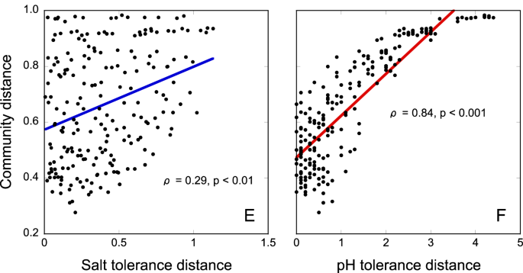
Mantel Tests: Regression of two distance matrices
Relationships between pairwise differences in community composition (Bray–Curtis dissimilarities) and community trait distributions (Euclidean distances). The fitted lines show linear regression curves between pairwise community distances and tolerance trait distances. Statistics (ρ) were calculated through Mantel tests (Spearman rank correlation). Panels E & F are from the native vegetation gradient only
Rath et al., 2019, ISME

Slide 22
Recreating these mantel graphs:
>Ydist <- vegdist(asv.table, method = “bray”)
>Xdist <- vegdist(meta$DPPH, method = “Euclid”)
>vegan::mantel(Xdist, Ydist, method = “spear”)
>lm.man <- lm(Xdist~Ydist) # creates a linear regression
>plot(Xdist~Ydist, ylab = “Bray-Curtis Dissimilarity”, xlab= “DPPH Dissimilarity, pch = 19, frame = FALSE, cex = 2, font = 2)
>abline(lm.man, col = “blue”, lty = 1, lwd = 4)
# then I would add on the R2 and p-values generated when I run ‘vegan::mantel’ like so:
>text(0.5, 0.5, ”R-sq : XX“) # change ‘XX’ to the actual value
>text(0.4, 0.5, “p-value : XX”) # change ‘XX’ to the actual value

Slide 23
For some examples of what is possible, check out these papers:
Soil bacterial and fungal communities across a pH gradient in an arable soil, Rousk et al., 2010
Network analysis reveals functional redundancy and keystone taxa amongst bacterial and fungal communities during organic matter decomposition in an arable soil, Banerjee et al., 2016
Contrasting environment preferences of photosynthetic and non-photosynthetic cyanobacteria across the globe, Cano-Díaz et al. 2020
Local community assembly mechanisms shape soil bacterial ß diversity patterns along a latitudinal gradient
Distinct biogeographic patterns for archaea, bacteria, and fungi along the vegetation gradient at the continental scale in eastern China

Slide 24
Time Series Analyses

Slide 25
Phyloseq object
Bar chart/heat maps
Alpha-diversity
Beta-diversity
Differential Abundance Analyses
Phylogenetic tree(?)
linear modeling with repeated measures
Extract distances and plot over time
Network Analyses
DESeq2 or corncob, repeated measures
Quantify differences in alpha-diversity over time compared to baseline and plot
Linear mixed effect modeling with specific network properties
Plot network properties over time
MVAbund

Slide 26
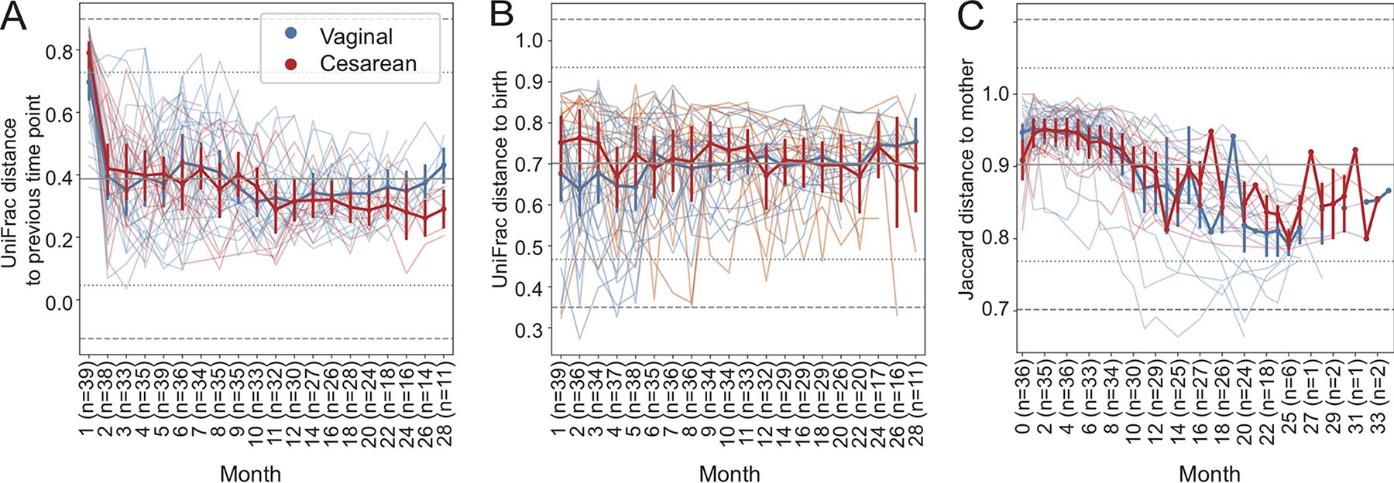
Use beta-diversity distances in time-series graph
FIG 3 Volatility charts of longitudinal change in unweighted UniFrac distances between successive samples collected from the same subject (first distances) in the ECAM data set (A), distance from baseline for each subject (B), and Jaccard distance (proportion of features not shared) between children’s and their mothers’ stool microbiotas.
Bokulich et al., 2018 mSystems

Slide 27
Look at connectedness/centrality/number of HUB taxa over time
Extract connectedness value, centrality values, numbers of hub taxa etc. and look at those other your time points.
Schmidt et al., 2019, Microbiome

Slide 28
Here are some papers for inspiration:
Dormancy dynamics and dispersal contribute to soil microbiome resilience, Sorensen and Shade, 2020, Phil Trans R Soc
Integration of time-series meta-omics data reveals how microbial ecosystems respond to disturbance, Herold et al., 2020, Nature Communications
Time after time: temporal variation in the effects of grass and forb species on soil bacterial and fungal communities, Hannula et al., 2019, mBio
Time-series using mvabund: http://edild.github.io/mvabund/

Slide 29
The ‘microbiome’ package has some nice tutorials on different data analyses and incorporating time-series sampling into the analyses You can explore the different types of analyses here: https://microbiome.github.io/tutorials/

Slide 30
I didn’t even mention using machine learning…
I would recommend that people check out Pat Schloss’ work, he implements machine learning in many of his papers
His group recently published a paper that compared different machine learning models and I think this would be informative
’A framework for effective application of machine learning microbiome-based classification problems’ – Topçuoǧlu et al., 2020, mBio

Slide 31
Sometimes you need to be creative Go back to your research question/hypothesis Consider what sort of analysis would actually be relevant for your specific project Search for other papers that might have done a similar analysis – If you are lucky, their code is available, and if you are even more lucky, their code storage makes sense and is easy to replicate ☺

